Slide 1
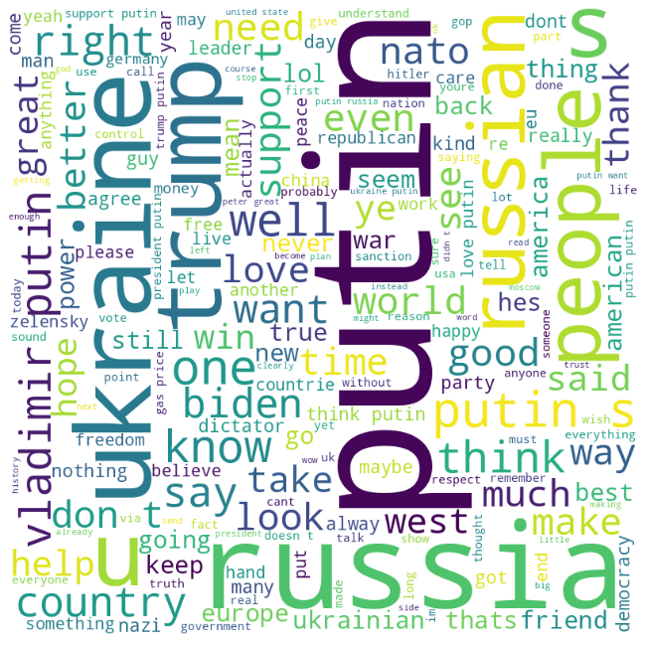
UKRAINE'S IMAGE IN THE WORLD STAGE SINCE RUSSIA'S INVASION: A SENTIMENT ANALYSIS REPORT
By Group 12:
Liyuan Chen
Srikanth Ranganathan
Gokul Ravi
Hanin Afzal
Mahendhar Kumar

Slide 2
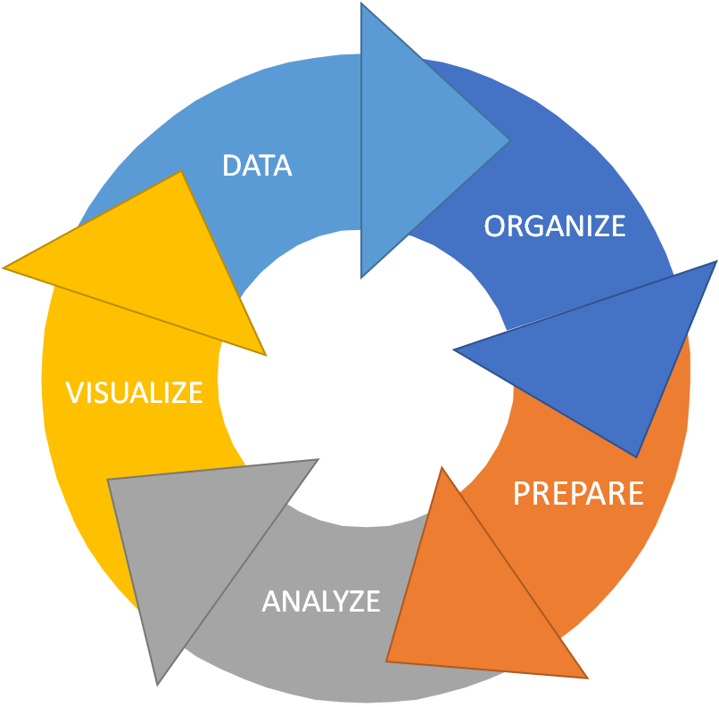



TABLE OF CONTENTS
1. DATA COLLECTION
2. ANALYSIS
3. DISCUSSION AND RECOMMENDATIONS

Slide 3


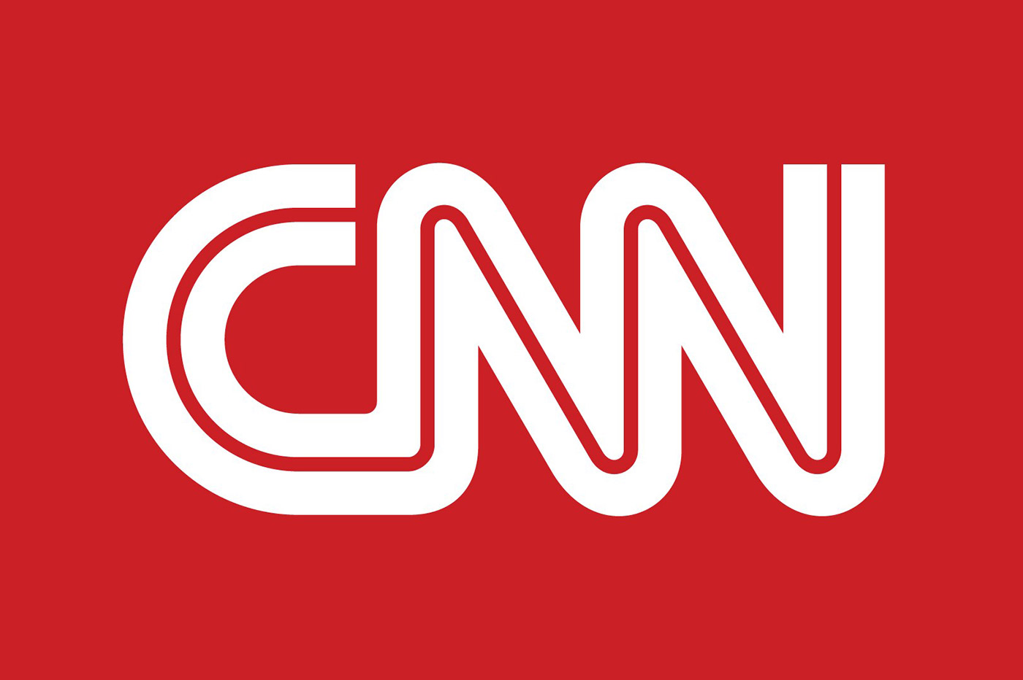


DATA COLLECTION
News articles
Twitter tweets
Reddit Posts
News articles were scraped to validate sentiment analysis and the factors identified.
Tweets from two periods: May-Jul 2022 and Jan-Mar 2023 were collected.
Reddit posts from May-Jul 2022 and Jan-Mar 2023 were collected for

Slide 4
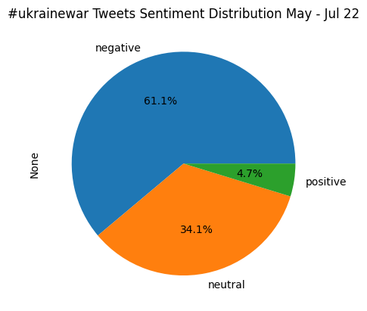
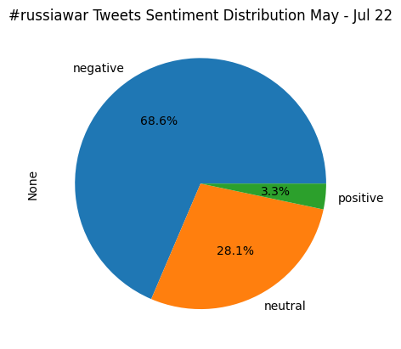
Analysis – Twitter Tweets
The percentage of negative tweets increases from #ukrainewar to #russiawar
Notes:
This initial analysis provides a breakdown in the distribution of positive negative and neutral tweets under the two hashtags # ukr war and #rus war. As you can see, when the war is framed more as a war of Russian aggression and invasion as the Russiawar, there more than 10% increase in share of negative tweets, thus representing a large negative association among the public of russias role as the aggressor

Slide 5
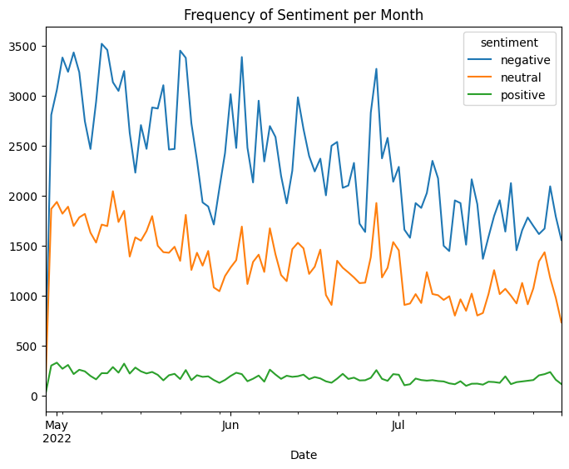
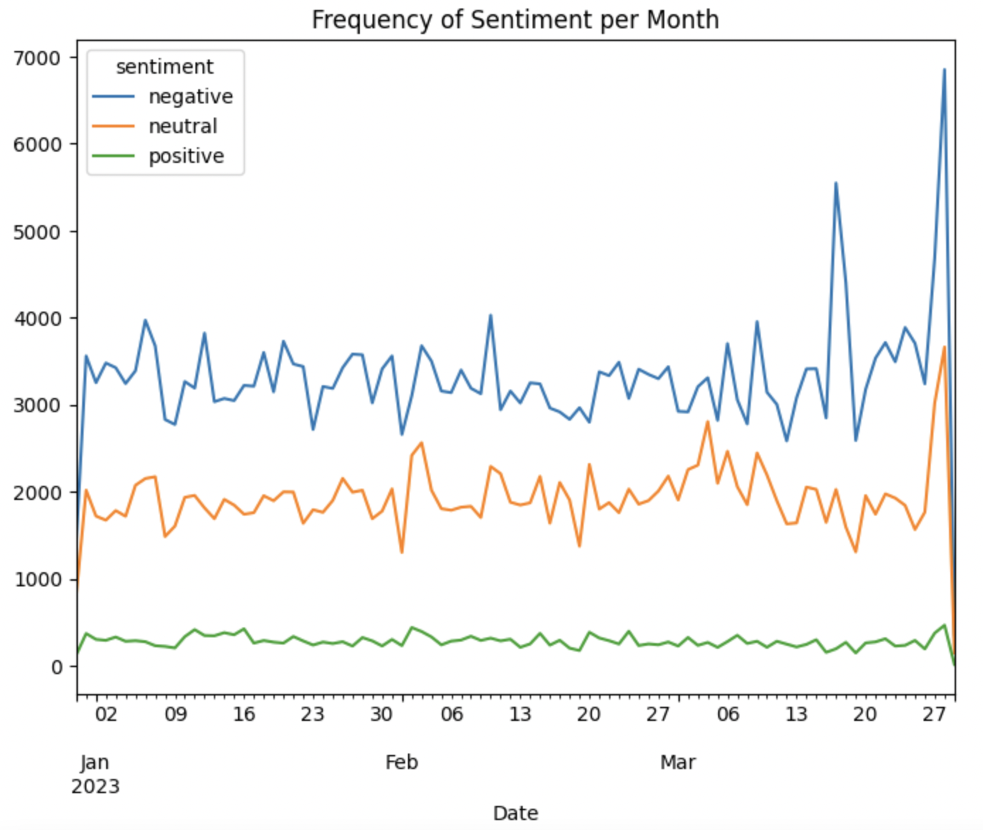
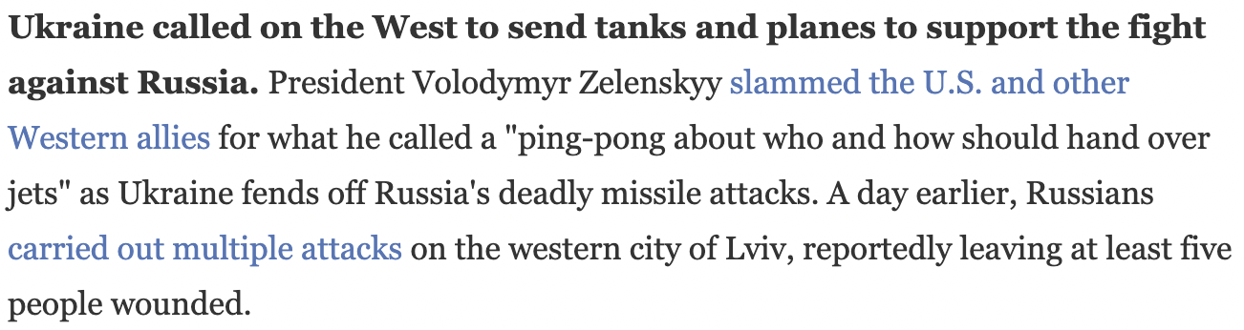
Analysis – Twitter Tweets
#ukrainewar
May – July '22
January – March '23
Notes:
https://www.npr.org/2022/03/27/1089062104/russia-ukraine-war-what-happened-today-march-27

Slide 6
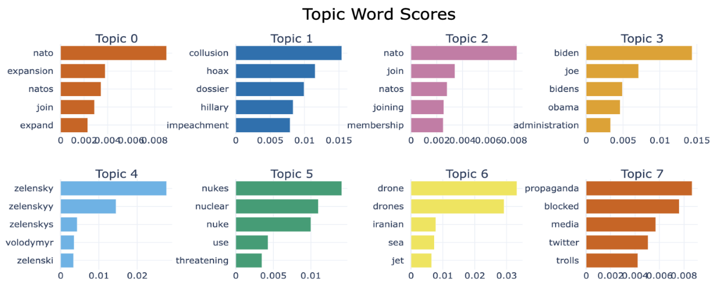
Positive Factors Identified
#ukraine
#ukrainewar
Notes:
(January – March 2023)

Slide 7
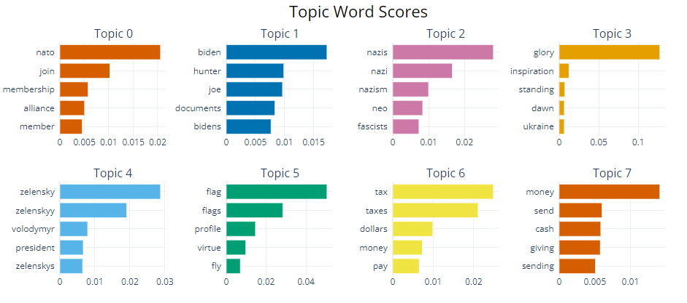
Negative Factors Identified
#ukrainewar
Notes:
(January – March 2023)

Slide 8
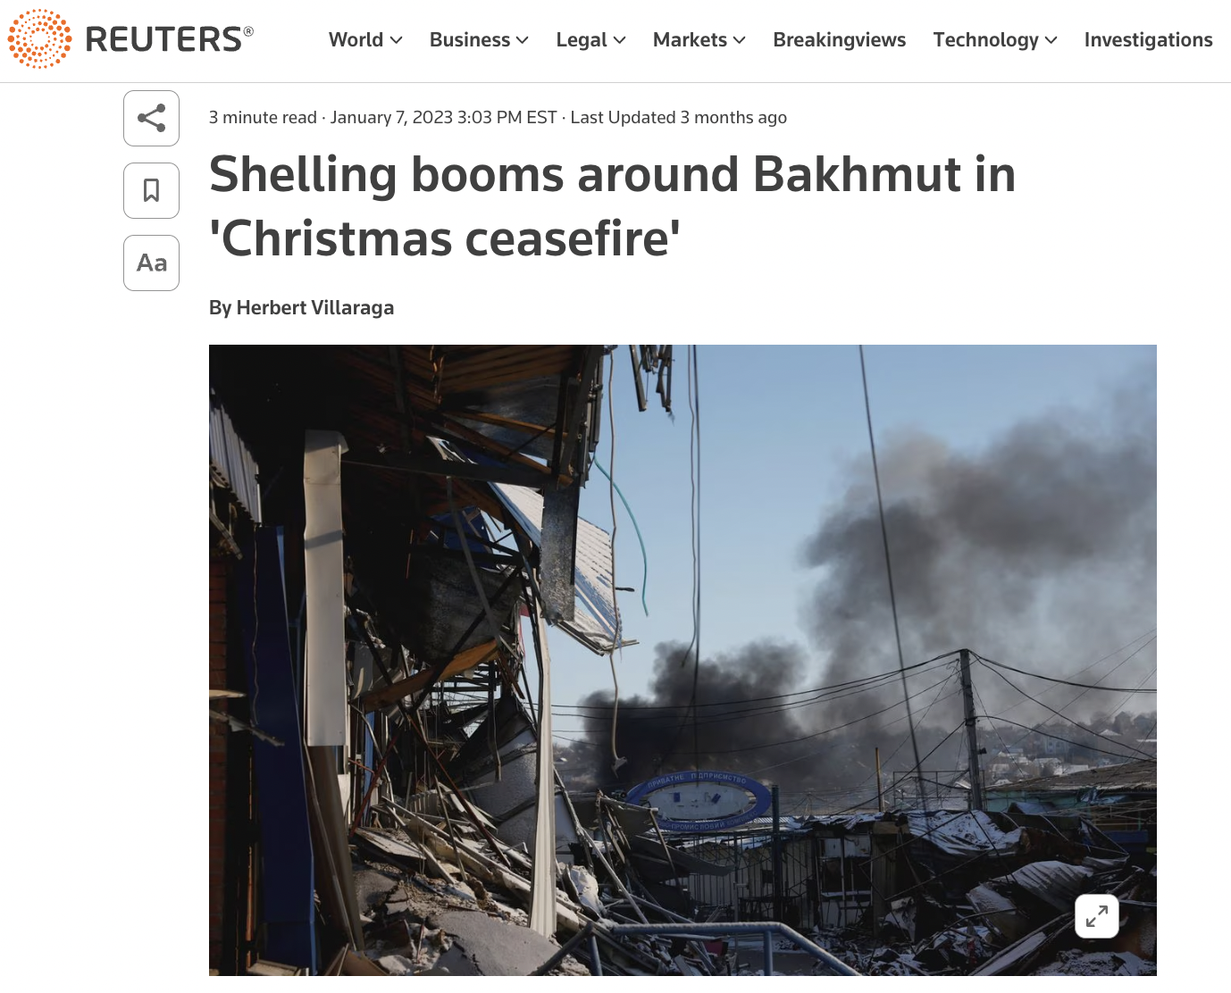
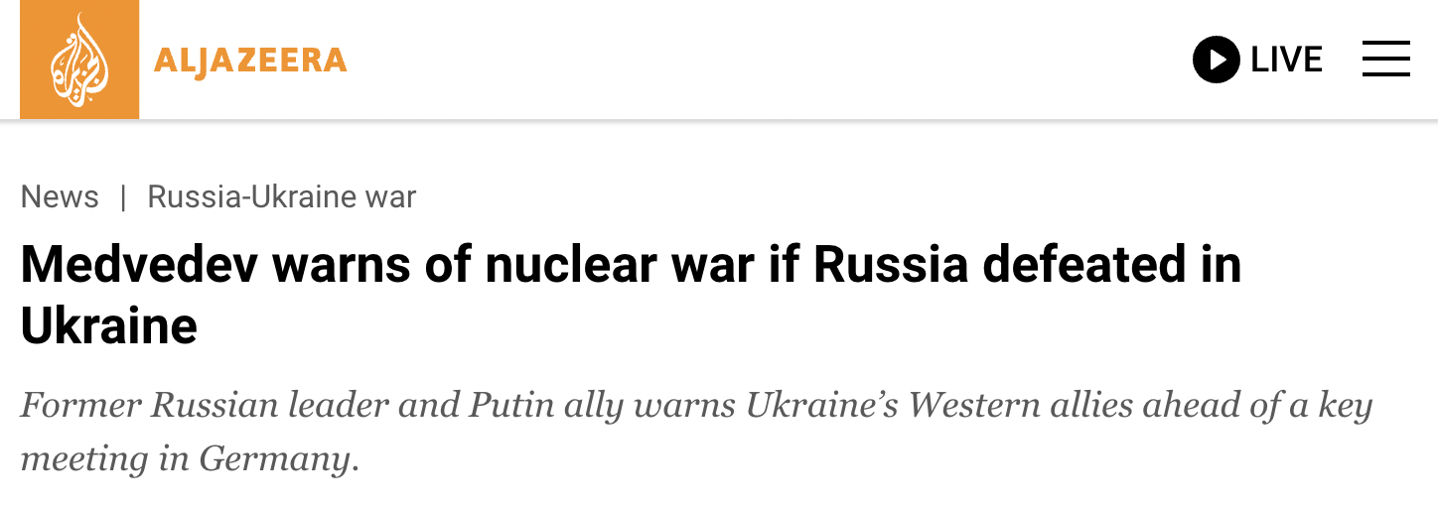
Factors Driving Sentiments
FACTORS DRIVING POSITIVE SENTIMENT | FACTORS DRIVING NEGATIVE SENTIMENT
1. Ukraine’s skepticism and denial of Russia’s request for a ceasefire during Orthodox Christmas. | 1. Billions of tax dollars spent on supporting the Ukrainian government on the war.
2. Expansion of NATO and its Allied Members. | 2. The threat of a nuclear war and the use of nuclear weapons.
3. Trust in Ukrainian leadership. | 3. The inflation of Oil & Gas prices.
 | 4. Ukrainian population accused of Neo-Nazism.

Slide 9
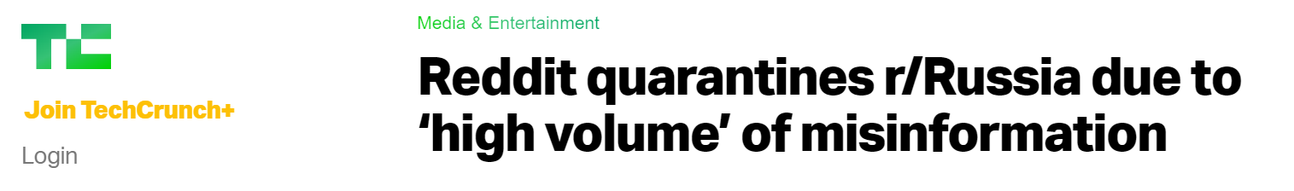
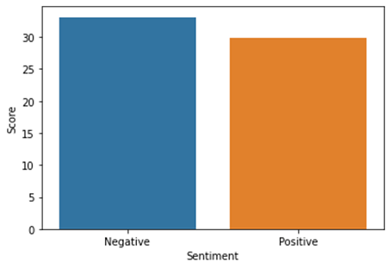
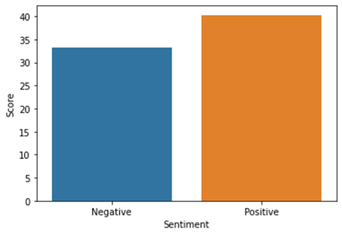
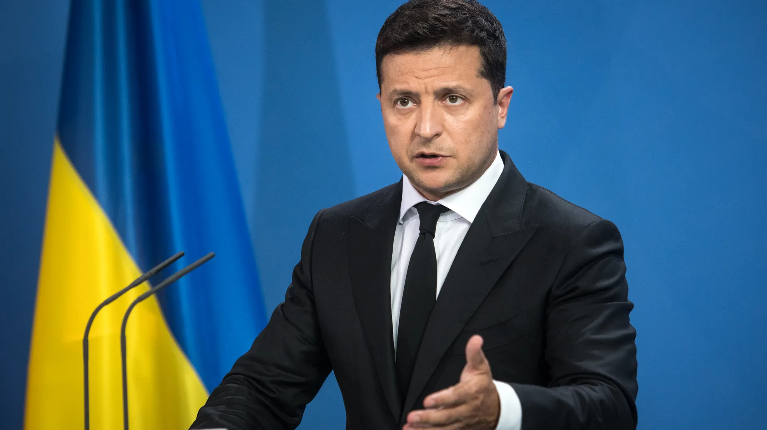
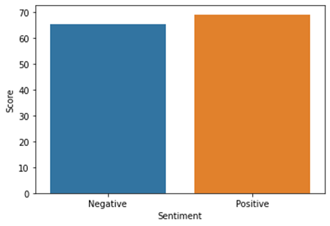

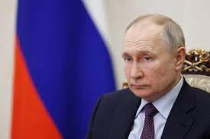
Analysis: Reddit
2022
2023

Slide 10
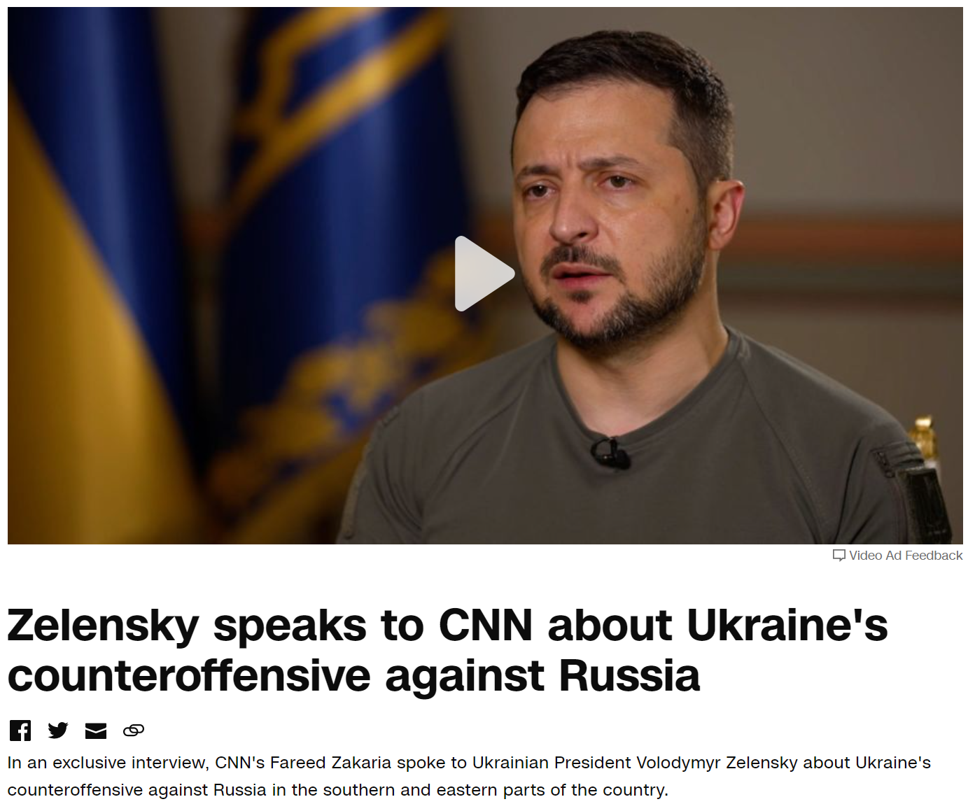
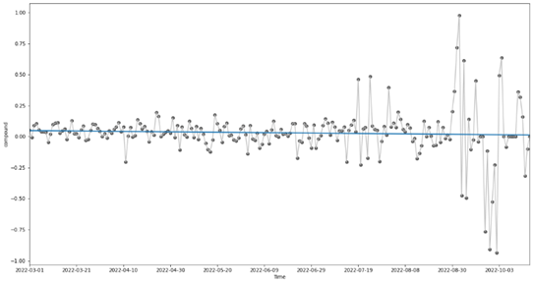
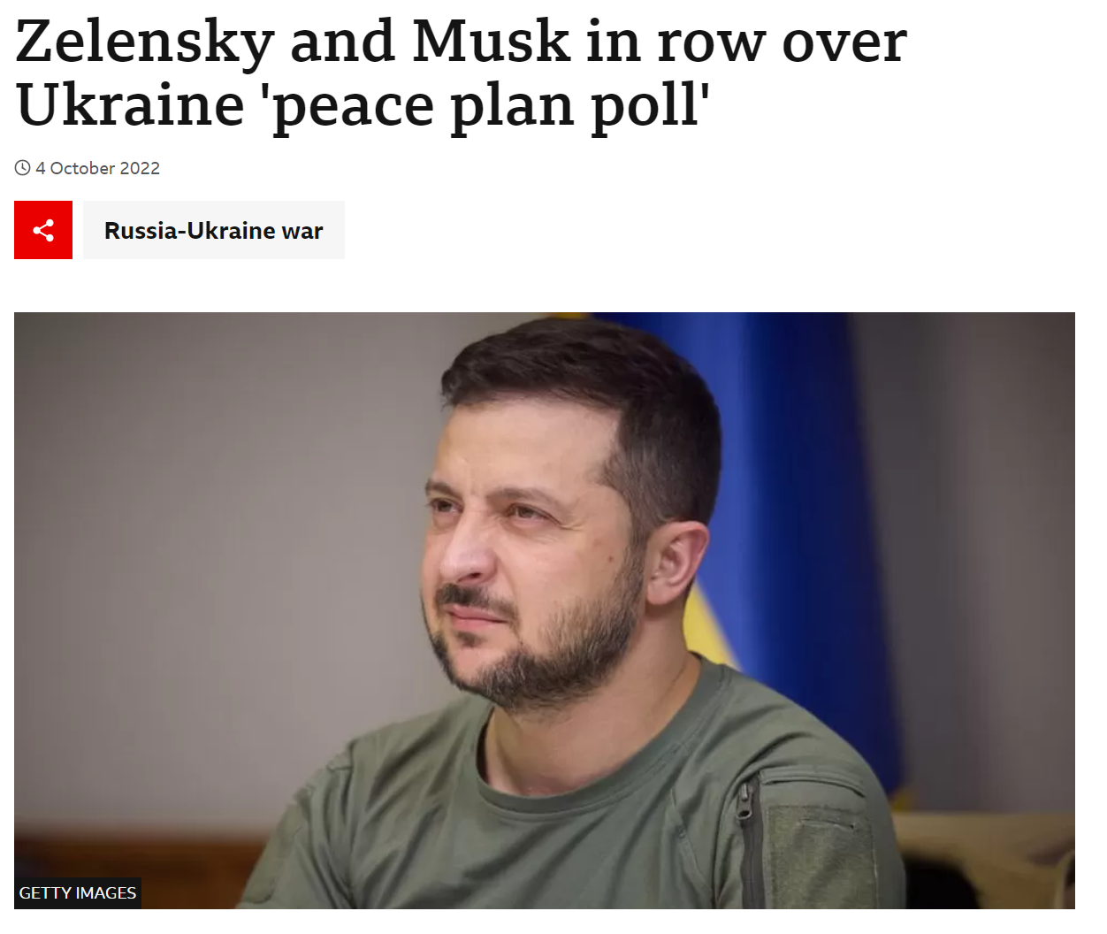
Daily Mean Sentiment Score: President Zelensky

Slide 11
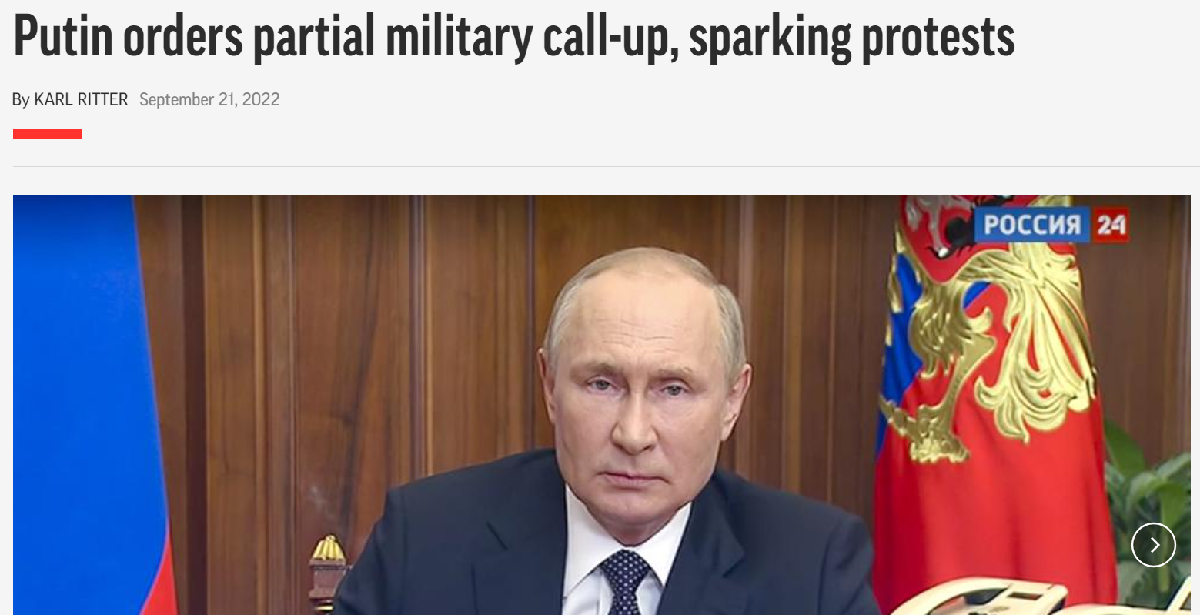
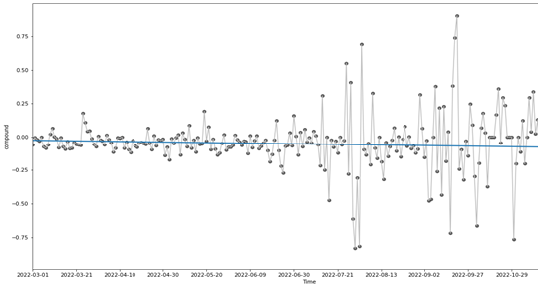
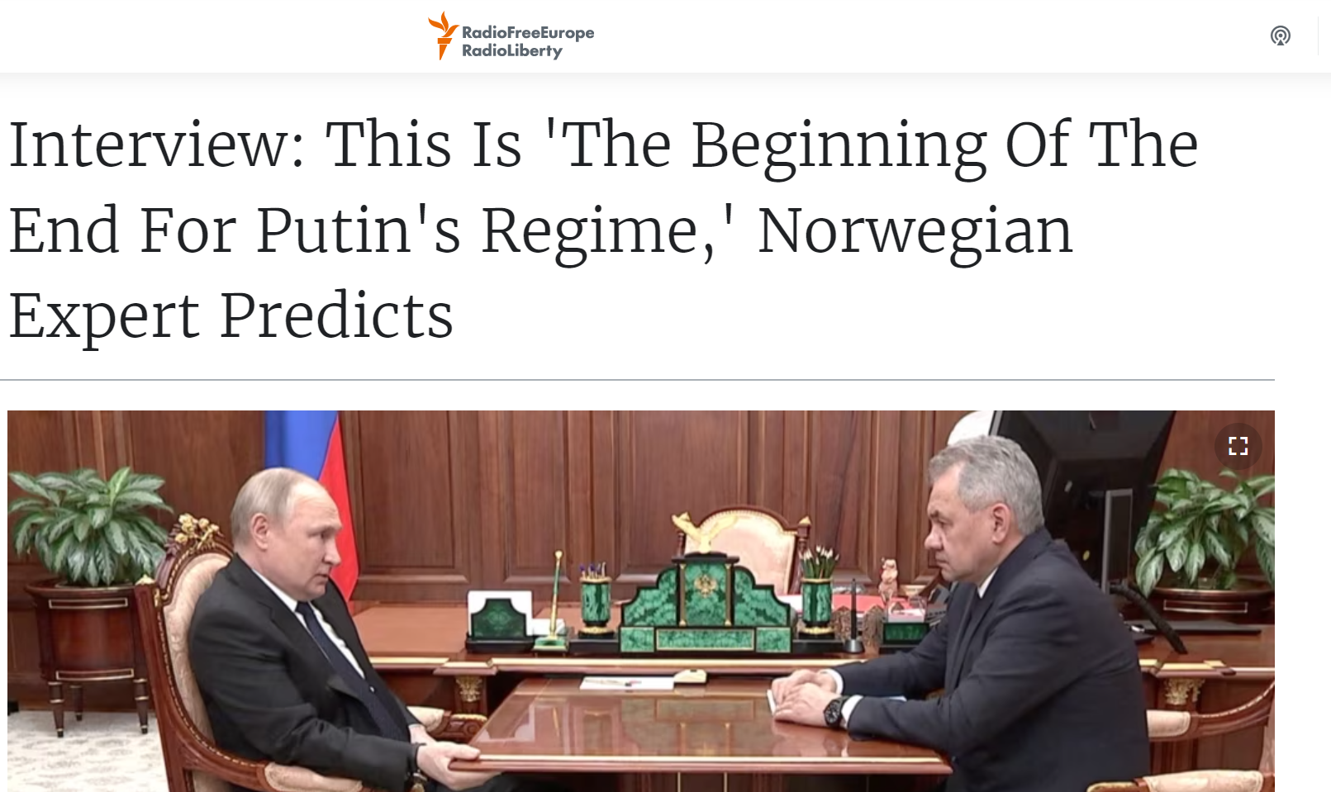
Daily Mean Sentiment Score: Putin

Slide 12
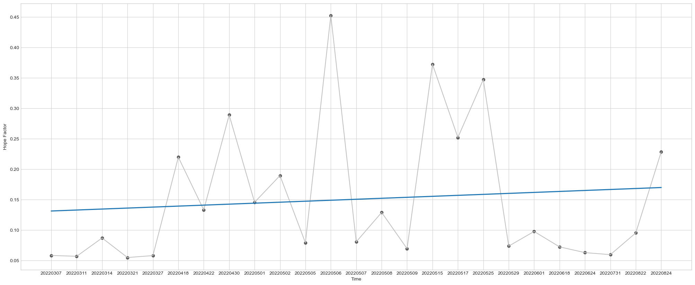
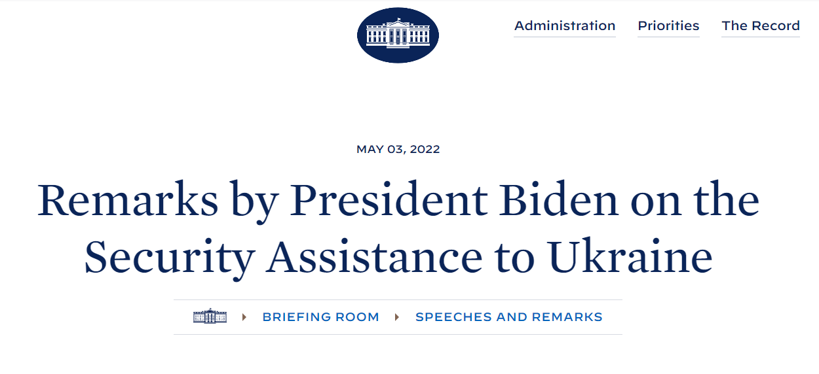
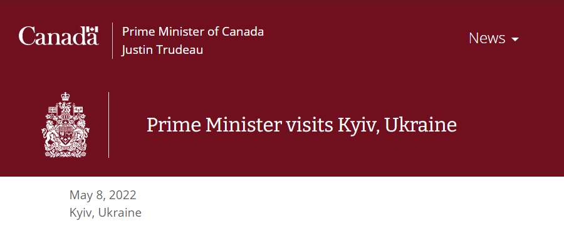
Daily Mean Hope Factor

Slide 13
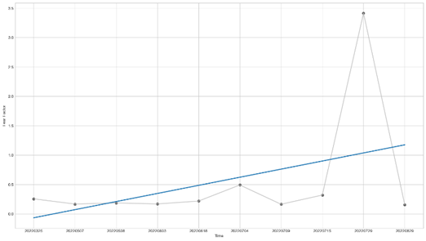
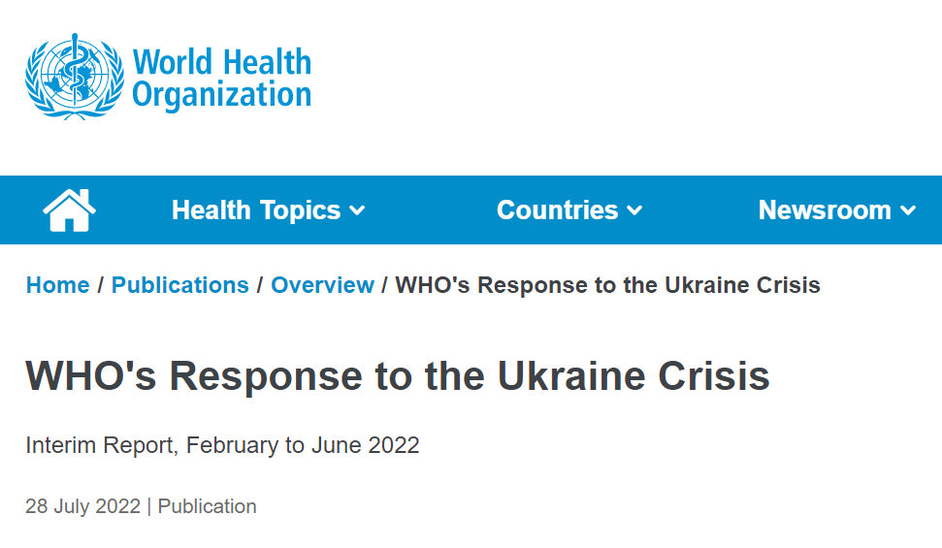
Daily Mean Fear Factor

Slide 14
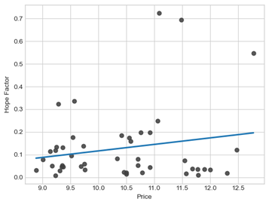
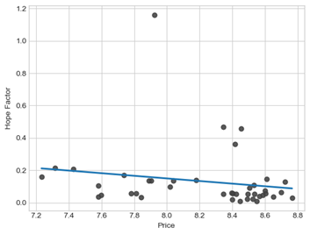
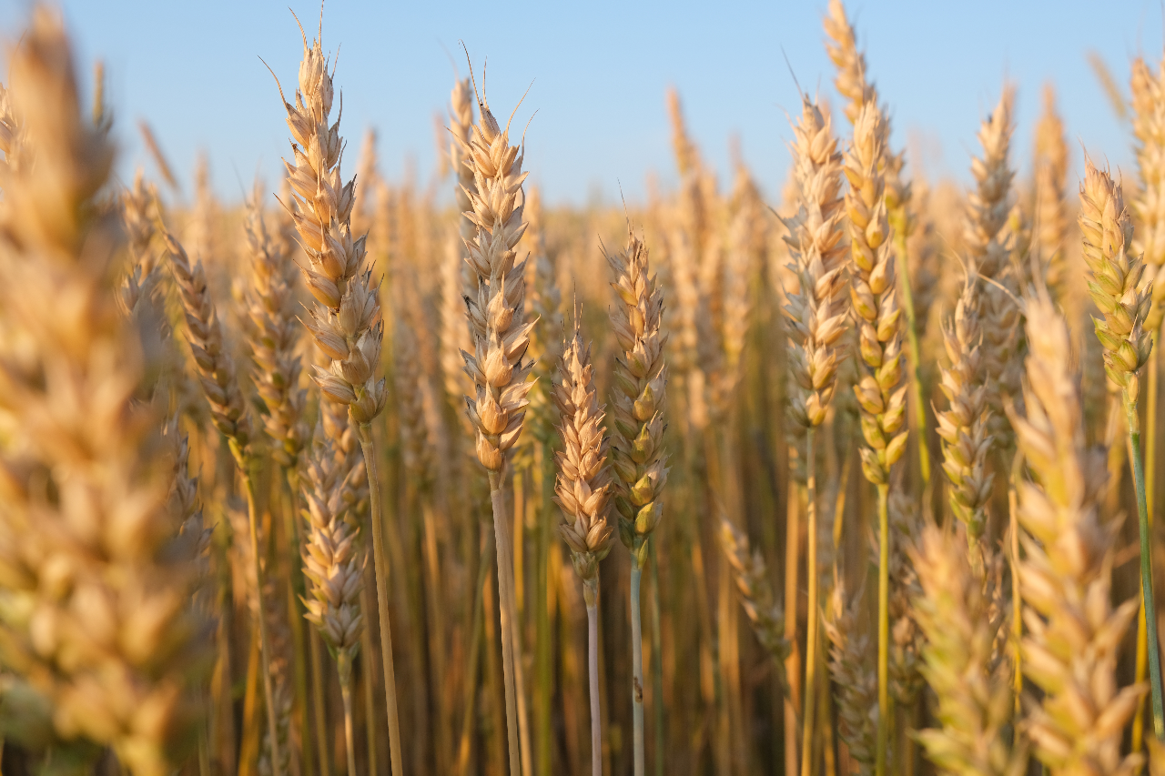
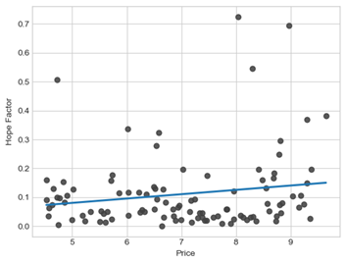
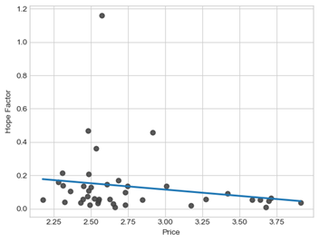
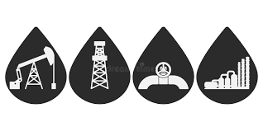
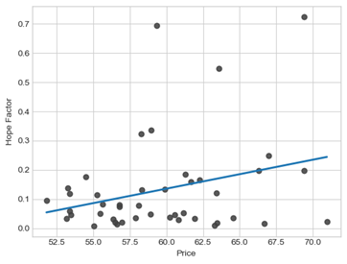
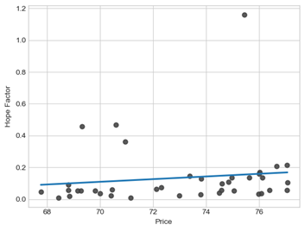
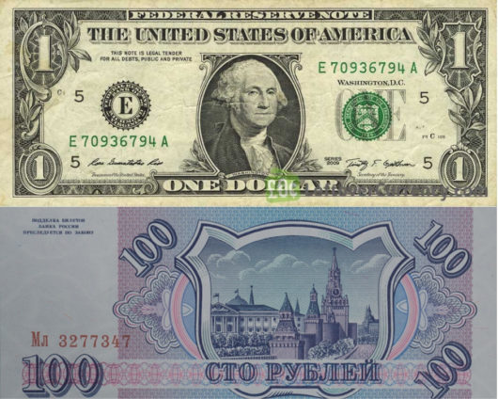
Stock Analysis
2022
2023
Wheat
Gas
USD-Ruble
Notes:
This analysis means that the public hope for the result of the conflict is not the primary driver for gas, Oil and Exchange prices, but there is indeed a relationship to be explored.

Slide 15
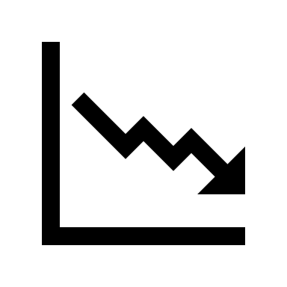



Discussion
Looming global economic recession
Public fear around financial support for Ukraine
Conflict impacts global supply chain.
Poor public sentiment may force negotiations.

Slide 16




Recommendation
Transparent communication regarding aid and war gains
Proliferation of information regarding Russian economic and military losses
Lobbying for regulation tackling Russian disinformation
Highlighting the positive financial impacts provided by Ukrainian refugees to host nations through consumption, labor and taxation

Slide 17
THANK YOU

